Slide 1
Chapter 4
Attention

Slide 2
What is Attention?
The ability to focus on specific stimuli or locations in our environment
  Selective: attending to one thing while ignoring others
  Divided: paying attention to more than one thing at a time
Notes:
Attention is super important! It underlies basically everything we do! (memory, perception, etc.)
Often talk about attention as a resource – attention gets depleted and then replenished.
Particularly interest in how attention is focused – selective studies
Also whether or not individuals can attend to multiple things at a time

Slide 3
Selective Attention
  It is the ability to focus on one message and ignore all others.
  We do not attend to a large fraction of the information in the environment.
  We filter out some information and promote other information for further processing.

Slide 4
Research Method: Dichotic Listening (1 of 3)
One message is presented to the left ear and another to the right ear.
Participant “shadows” one message to ensure he is attending to that message.
Can we completely filter out the message to the unattended ear and attend only to the shadowed message?

Slide 5
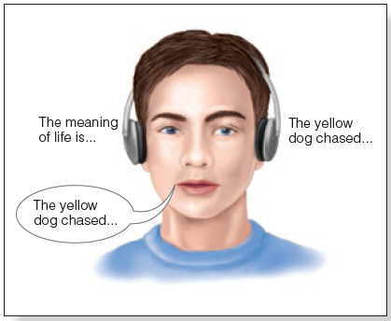
Research Method: Dichotic Listening (2 of 3)
Figure 4.2 In the shadowing procedure, which involves dichotic listening, a person repeats out loud the words that they have just heard. This ensures that participants are focusing their attention on the attended message.

Slide 6
Research Method: Dichotic Listening (3 of 3)
Participants could not report the content of the message in unattended ear:
  Knew that there was a message
  Knew the gender of the speaker
However, unattended ear is being processed at some level:
  Cocktail party effect
  Change in gender is noticed
  Change to a tone is noticed

Slide 7
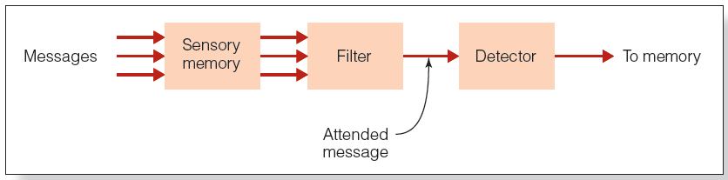
Broadbent’s Filter Model (1 of 3)
Early selection model
  Filters message before incoming information is analyzed for meaning

Slide 8
Broadbent’s Filter Model (2 of 3)
Sensory memory
  Holds all incoming information for a fraction of a second
  Transfers all information to next stage
Filter
  Identifies attended message based on physical characteristics
  Only attended message is passed on to the next stage

Slide 9
Broadbent’s Filter Model (3 of 3)
Detector
  Processes all information to determine higher-level characteristics of the message
Short-term memory
  Receives output of detector
  Holds information for 10–15 seconds and may transfer it to long-term memory

Slide 10
Broadbent’s Model Could Not Explain…
Why participant’s name gets through
  Cocktail party phenomenon
Why participants can shadow meaningful messages that switch from one ear to another
  Dear Aunt Jane (Gray & Wedderburn, 1960)

Slide 11
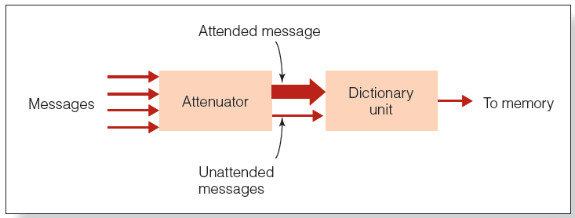
Treisman’s Attenuation Model (1 of 3)
Intermediate selection model
  Attended message can be separated from unattended message early in the information-processing system.
  Selection can also occur later.

Slide 12
Treisman’s Attenuation Model (2 of 3)
Attenuator
  It analyzes incoming message in terms of physical characteristics, language, and meaning.
Attended message is let through the attenuator at full strength.
Unattended message is let through at much weaker strength.

Slide 13
Treisman’s Attenuation Model (3 of 3)
Dictionary unit
  Contains words, each of which has a threshold for being activated
    Words that are common or important have low thresholds (get through easily!)
    Uncommon words have high thresholds (hard to get through!)

Slide 14
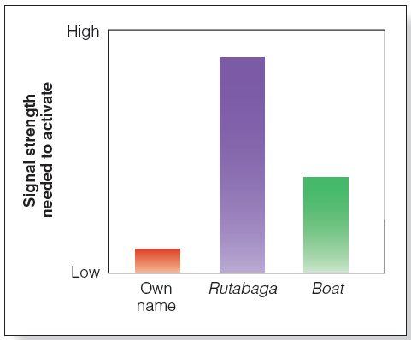
Treisman’s Attenuation Model (3 of 3)

Slide 15
Late Selection Models (1 of 2)
Selection of stimuli for final processing does not occur until after information has been analyzed for meaning.
MacKay (1973)
  In attended ear, participants heard ambiguous sentences.
    “They were throwing stones at the bank.”
  In unattended ear, participants heard either “river” or “money.”

Slide 16
Late Selection Models (2 of 2)
Participants chose which was closest to the meaning of attended message:
  “They threw stones toward the side of the river yesterday.”
  “They threw stones at the savings and loan association yesterday.”
Meaning of the biasing word affected participants’ choice.
Participants were unaware of the presentation of the biasing words.

Slide 17
Load Theory of Attention
Processing capacity—how much information a person can handle at any given moment
Perceptual load—the difficulty of a given task
  High-load (difficult) tasks use higher amounts of processing capacity
  Low-load (easy) tasks use lower amounts of processing capacity

Slide 18
The Stroop Test (1 of 3)
Stroop effect
  Name of the word interferes with the ability to name the ink color
  Cannot avoid paying attention to the meanings of the words

Slide 19
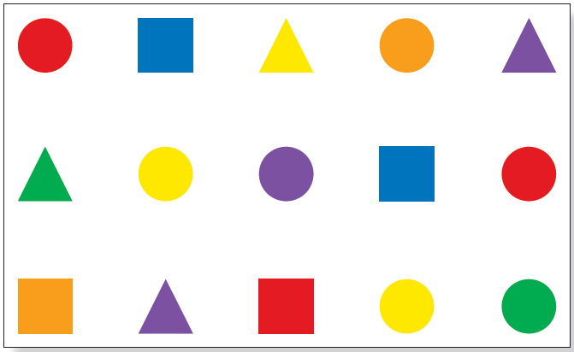
The Stroop Test (2 of 3)
Figure 4.9 Name the color of the ink used to print these shapes.

Slide 20
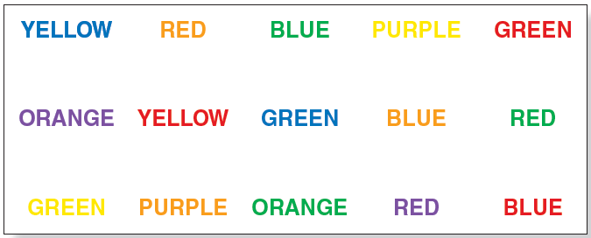
The Stroop Test (3 of 3)
.
Take the test! https://www.psytoolkit.org/experiment-library/stroop.html

Slide 21
Overt Attention
Eye movements, attention, and perception
  Saccades: rapid movements of the eyes from one place to another
  Fixations: short pauses on points of interest
  Studied by using an eye tracker

Slide 22

Bottom-up Determinants of Eye Movement
Stimulus salience: areas that stand out and capture attention
  Bottom-up process
  Depends on characteristics of the stimulus
  Color and motion are highly salient

Slide 23
Top-Down Determinants of Eye Movements (1 of 2)
Scene schema: knowledge about what is contained in typical scenes
  Help guide fixations from one area of a scene to another
Eyes movements are determined by task
  Eyes movements preceded motor actions by a fraction of a second

Slide 24
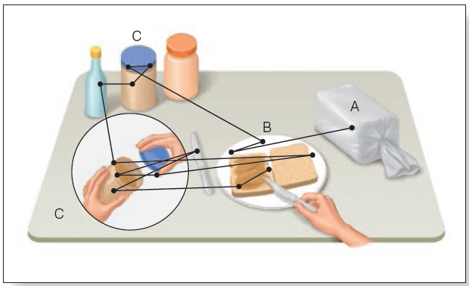
Top-Down Determinants of Eye Movements (2 of 2)
Figure 4.15 Sequence of fixations of a person making a peanut butter sandwich. The first fixation is on the loaf of bread.
Notes:
(Source: Adapted from M. F. Land, N. Mennie, & J. Rusted, The roles of vision and eye movements in the control of activities of daily living, Perception, 28, 11, 1311–1328. Copyright © 1999 by Pion Ltd, London. Reproduced by permission. www.pion.co.uk and www.envplan.com.)

Slide 25
Covert Attention: Attention Without Eye Movements
Precueing: directing attention without moving the eyes
  Participants respond faster to a light at an expected location than at an unexpected location
  Even when eyes kept fixed

Slide 26
Divided Attention (1 of 4)
Practice enables people to simultaneously do two things that were difficult at first.
Schneider and Shiffrin (1977)
  Divide attention between remembering target and monitoring rapidly presented stimuli
    Memory set: one to four characters called target stimuli
    Test frames: could contain random dot patterns, a target, distractors

Slide 27
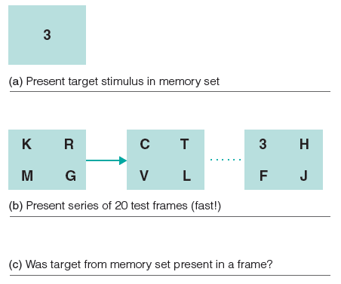
Divided Attention (2 of 4)
Figure 4.21 Sample stimuli for Schneider and Shiffrin’s (1977) experiment. In this experiment, there is one target stimulus in the memory set (the 3) and four stimuli in each frame. The target appears in the last frame in this example.
Notes:
Source: R. M. Shiffrin & W. Schneider, Controlled and automatic human information processing: Perceptual learning, automatic attending, and a general theory, Psychological Review, 84, 127–190, 1977.

Slide 28
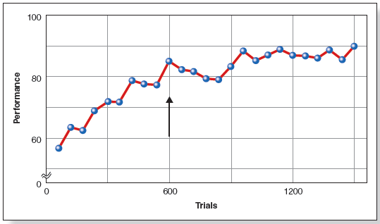
Divided Attention (3 of 4)
Figure 4.22 Improvement in performance with practice in Schneider and Schiffrin’s (1977) experiment. The arrow indicates the point at which participants reported that the task had become automatic. This is the result of experiments in which there were four target stimuli in the memory set and two stimuli in each test frame
Notes:
(Source: R. M. Shiffrin & W. Schneider, Controlled and automatic human information processing:
Perceptual learning, automatic attending, and a general theory, Psychological review, 84, 127–190, 1977.)

Slide 29
Divided Attention (4 of 4)
Automatic processing occurs without intention and only uses some of a person’s cognitive resources.

Slide 30
Distractions: Cell Phone Use
100-Car Naturalistic Driving Study
  Video recorders placed in cars
  Accident risk is 4X higher when using a cell phone.
Strayer and Johnston (2001):
  Simulated driving
  Participants on phone missed twice as many red lights and took longer to apply the brakes
    Same result using “hands-free” cell phone

Slide 31
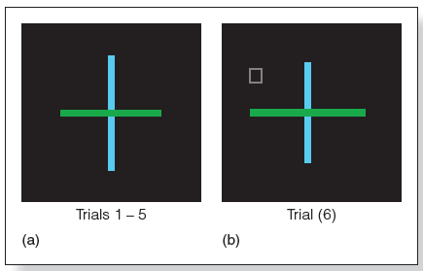
Attention and Visual Perception
Inattentional blindness:
  Stimulus that is not attended is not perceived, even though a person might be looking directly at it
Notes:
Figure 4.25 Inattentional blindness experiment. (a) The cross display is presented for five trials. On each trial, one arm of the cross is slightly longer than the other. The participant’s task is to indicate which arm (horizontal or vertical) is longer. (b) On the sixth trial, the participants carry out the same task, but a small square or other geometric object is included in the display. After the sixth trial, participants are asked whether they saw anything different than before.

Slide 32
Object-Based Visual Attention (1 of 3)
Location-based:
  Moving attention from one place to another
Object-based:
  Attention being directed to one place on an object

Slide 33
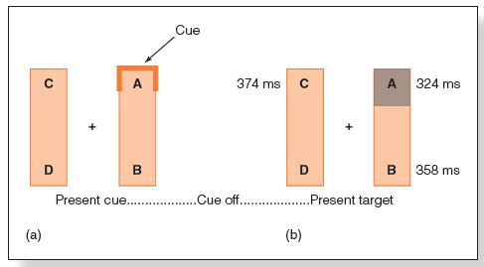
Object-Based Visual Attention (2 of 3)
Egly et al. (1994)
  Participants saw two side-by-side rectangles, followed by a target cue
  Reaction time fastest when target appeared where indicated
  Reaction time was faster when the target appeared in the same rectangle
Notes:
Figure 4.17 In Egly and coworkers’ (1994) experiment, (a) a cue signal appears at one place on the display, then the cue is turned off and (b) a target is flashed at one of four possible locations, A, B, C, or D. The participants’ task was to press a button when the target was presented anywhere on the display. Numbers are reaction times in ms for positions A, B, and C when the cue signal appeared at position A.

Slide 34
Object-Based Visual Attention (3 of 3)
The enhancing effect of attention spreads throughout the object
Attention can be based on the
  Environment
    Static scenes or scenes with few objects
  Specific object
    Dynamic events

Slide 35
Change Detection (1 of 2)
Change blindness:
  If shown two versions of a picture, differences between them are not immediately apparent.
  Task to identify differences requires concentrated attention and search.

Slide 36
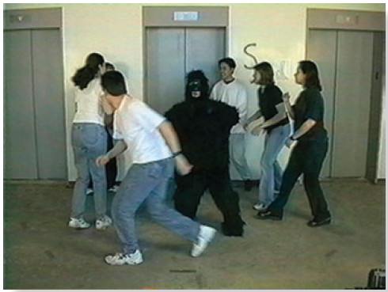
Change Detection (2 of 2)
Figure 4.26 Frame from the film shown by Simons and Chabris in which a person in a gorilla suit walks through the basketball game.
Notes:
(Source: D. J. Simons & C. F. Chabris, Gorillas in our midst:Sustained inattentional blindness for dynamic events, Perception, 28, 1059–1074, 1999. Pion Limited, London. Figure provided by Daniel Simons.)

Slide 37
Attention and Experiencing a Coherent World
Binding
  The process by which features such as color, form, motion, and location are combined to create our perception of a coherent object.
Notes:
Essentially all of the various things that allow us to detect an object.

Slide 38
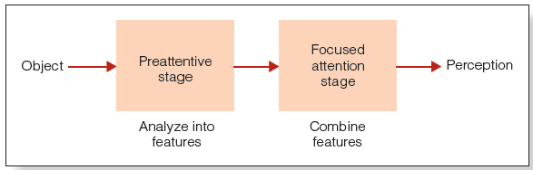
Feature Integration Theory (FIT) (1 of 6)
Notes:
Figure 4.30 Steps in Treisman’s feature integration theory. Objects are analyzed into their features in the preattentive stage, and the features are later combined with the aid of attention.

Slide 39
Feature Integration Theory (FIT) (2 of 6)
Preattentive stage
  Automatic
  No effort or attention
  Unaware of process
  Object analyzed into features

Slide 40
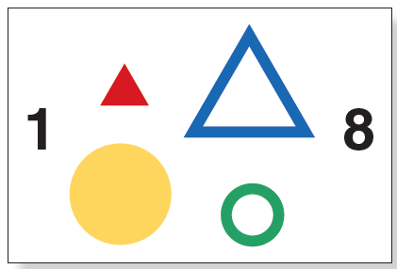
Feature Integration Theory (FIT) (3 of 6)
Treisman and Schmidt (1982)
  Participants report combination of features from different stimuli.
  Illusory conjunctions occur because features are “free floating.”

Slide 41
Feature Integration Theory (FIT) (4 of 6)
Focused attention stage
  Attention plays key role
  Features are combined
Treisman and Schmidt (1982)
  Ignore black numbers and focus on objects
  Participants can correctly pair shapes and colors

Slide 42
Feature Integration Theory (FIT) (5 of 6)
R.M.: Patient with Balint’s syndrome
  Inability to focus attention on individual objects
  High number of illusory conjunctions reported

Slide 43
Feature Integration Theory (FIT) (6 of 6)
Mostly bottom-up processing
Top-down processing influences processing when participants are told what they would see
  Top-down processing combines with feature analysis to help one perceive things accurately

